Slide 1



Movie Recommendation System
Supervised By:
Tushar Tkhitoliya
Submitted By:
Bhavika- 2210990219
Diyanshi -2210990305
Drishya Sood- 2210990307

Slide 2

Introduction
A movie recommendation system uses algorithms to suggest films to users based on their preferences and viewing history. By analyzing patterns in likes and dislikes of user and movie attributes, the system provides personalized movie recommendations, enhancing the user's viewing experience and helping them discover new content tailored to their tastes.

Slide 3
Why Recommendation System?
In today's era, people are increasingly fond of movies. After finishing one, they often struggle to decide what to watch next. Our project offers the perfect solution, providing personalized movie recommendations based on their preferences such as actor, rating, genre, and more. By leveraging advanced AI and ML techniques, our system ensures users receive tailored suggestions that match their unique tastes, enhancing their movie-watching experience and helping them discover new favorites effortlessly.

Slide 4

Recommendation Engine
Content Analysis
1
Examine movie attributes like genre, plot, cast, and reviews
Collaborative Filtering
2
Find users with similar tastes and recommend movies they enjoyed

Slide 5
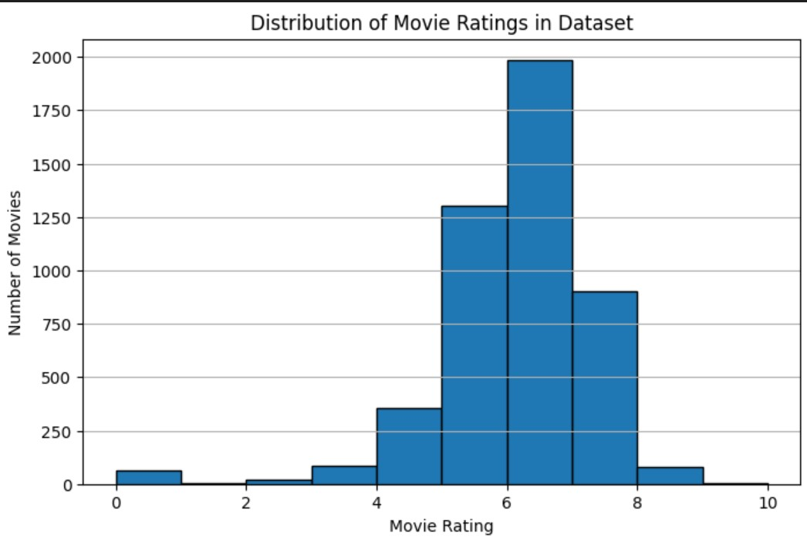
Graphical Representation

Slide 6
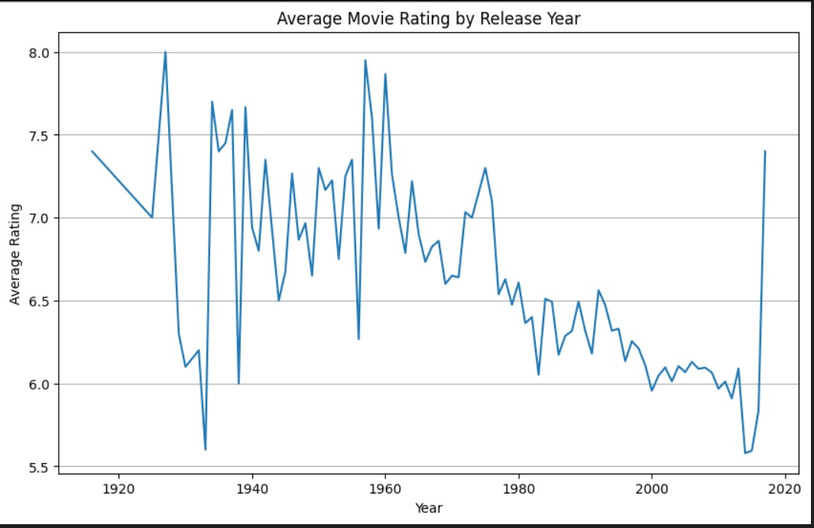
Graphical Representation

Slide 7
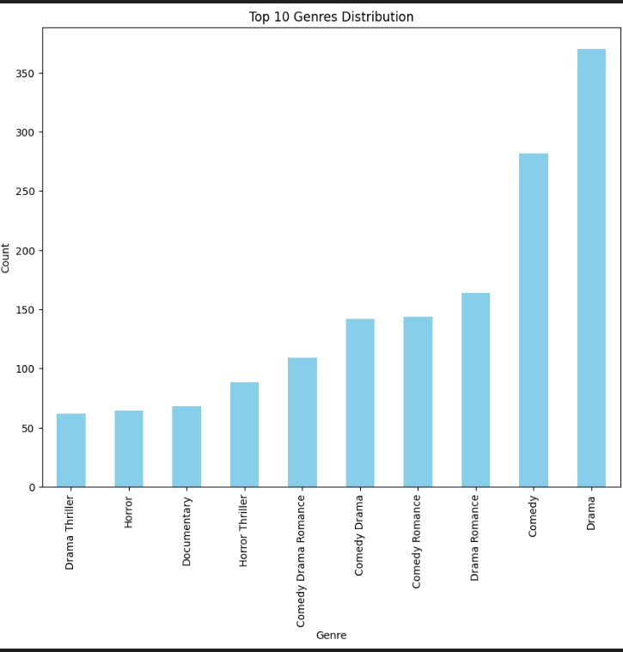
Graphical Representation

Slide 8
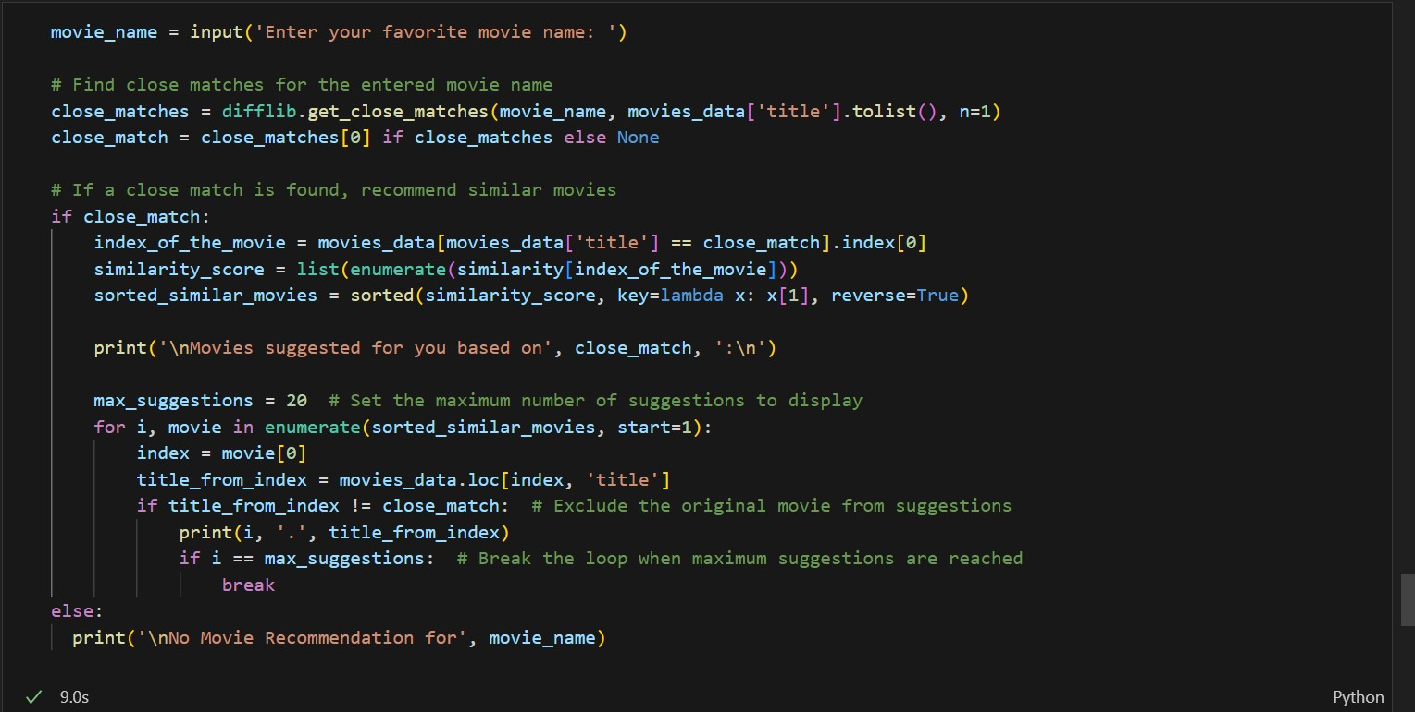
Cosine Similarity

Slide 9
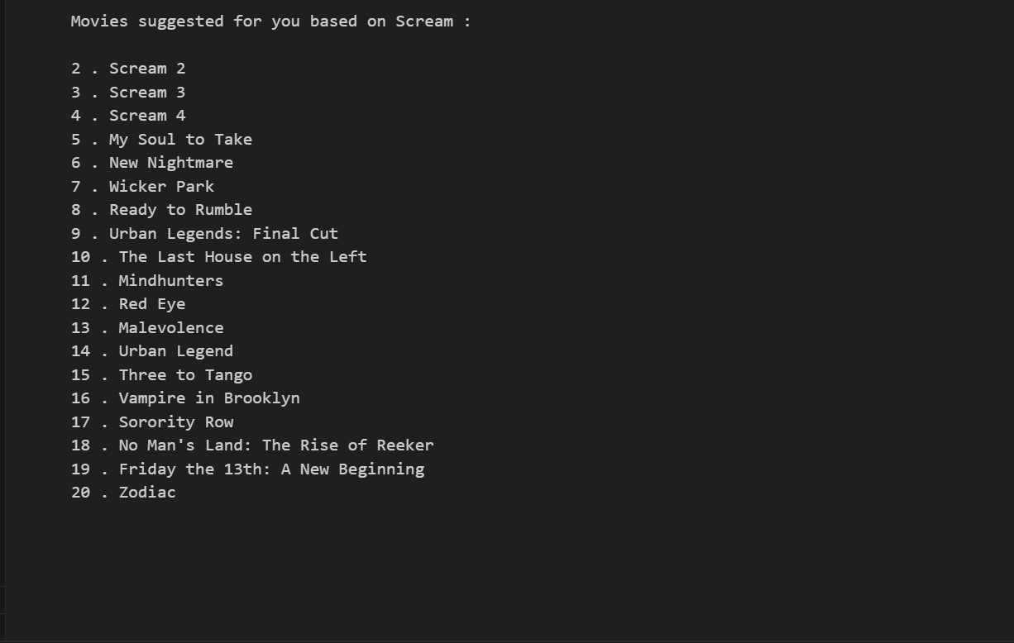
OUTPUT SNIPPET

Slide 10
Conclusion
Conclusion
Enhanced Cinematic Experience: Our machine learning models, such as Singular Value Decomposition (SVD) and K-Nearest Neighbors (KNN), significantly improve the movie-watching experience by providing personalized recommendations based on user preferences and movie attributes.
Transformative AI Impact: The use of artificial intelligence in entertainment transforms how viewers select and enjoy movies, creating a more engaging and immersive experience.
Data-Driven Insights: Personalized recommendations driven by data insights help viewers explore a wider range of movies that match their interests, enhancing their overall viewing pleasure.
Future of Entertainment: This project highlights the potential of AI and machine learning in revolutionizing movie discovery and enjoyment, paving the way for more innovative and personalized entertainment experiences.

Slide 11
THANK YOU
We appreciate you taking the time to explore our movie recommendation system. Thank you for your interest and valuable feedback.

